Slide 1
Jaringan Sistem Komunikasi Serat-Optik

Slide 2
Why Optical Communications?
Optical Fiber is the backbone of modern communication networks
  Voice (SONET/Telephony) - The largest traffic
  Video (TV) over Hybrid Fiber Coaxial (HFC)
  Fiber Twisted Pair for Digital Subscriber Loops (DSL)
  Multimedia (Voice, Data and Video) over DSL or HFC
Information revolution wouldn’t have
happened without the Optical Fiber

Slide 3
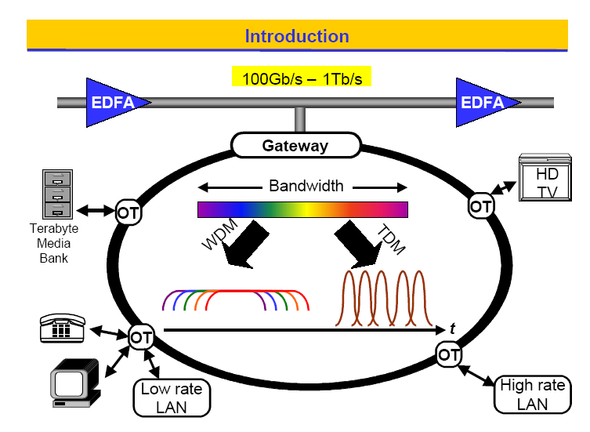

Slide 4
Why Optical Communications?
Lowest attenuation → attenuation in the optical fiber (at 1.3 µm and 1.55 µm bands) is much smaller than electrical attenuation in any cable at useful modulation frequencies
  Much greater repeater-less distances are possible
  Optical attenuation is independent of modulation frequency
Bandwidth/ broadband → high-speed →rich content
  Single Mode Fiber (SMF) offers the lowest dispersion → highest bandwidth
An SMF optical communication system can be upgraded to higher bandwidth by replacing only the transmitters and receivers

Slide 5
Why Optical Communications for you?
Most Electrical and Computer Engineers will eventually work in Information and Communications Technology (ICT) area
Canada produces 40% of the worlds optoelectronic products
Some of the worlds leading Photonic Facilities are located in this region (Ottawa, Quebec…)

Slide 6
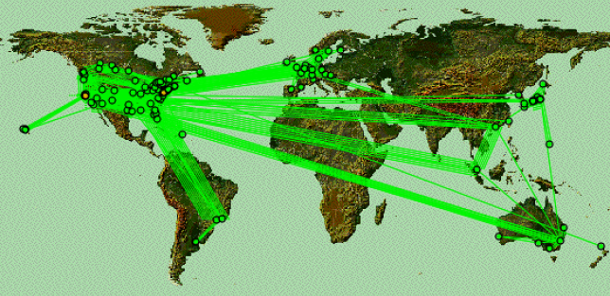
The UUNet Commercial Internet

Slide 7
Optical Communication Systems
Digital fiber optic (SONET) systems
Microwave (analog) fiber optic (MFO) Systems
Radio over fiber systems for wireless communications (ROF)
Line of sight Infrared fixed wireless systems (Free Space Optics)
Diffused infrared indoor wireless systems

Slide 8
Digital Fiber Optic Systems (SONET/SDH)
High speed inter-city, intra-city, WAN type network with well defined standards and bit rates up 6.4 Tb/s
(Nortel Networks OPTera 5000)

Slide 9
Synchronous Optical Networks
SONET is the TDM optical network standard for North America (called SDH in the rest of the world)
We focus on the physical layer
STS-1, Synchronous Transport Signal consists of 810 bytes over 125 us
27 bytes carry overhead information
Remaining 783 bytes: Synchronous Payload Envelope

Slide 10
SONET/SDH Bit Rates
SONET | Bit Rate (Mbps) | SDH
OC-1 | 51.84 | -
OC-3 | 155.52 | STM-1
OC-12 | 622.08 | STM-4
OC-24 | 1244.16 | STM-8
OC-48 | 2488.32 | STM-16
OC-96 | 4976.64 | STM-32
OC-192 | 9953.28 | STM-64

Slide 11
Microwave Fiber Optic (MFO) Analog Systems
Conventionally used for CATV Distribution (Fiber-Coax Systems) and recently for multimedia delivery via high-speed internet cable modems

Slide 12
Analog Systems
Modulating signal is analog (RF)
Several RF carriers can be transmitted over a single fiber in FDM manner called Sub Carrier Multiplexing
Each RF Carrier is an independent communication channel
  Ex: CATV Systems
Linearity is the biggest concern

Slide 13
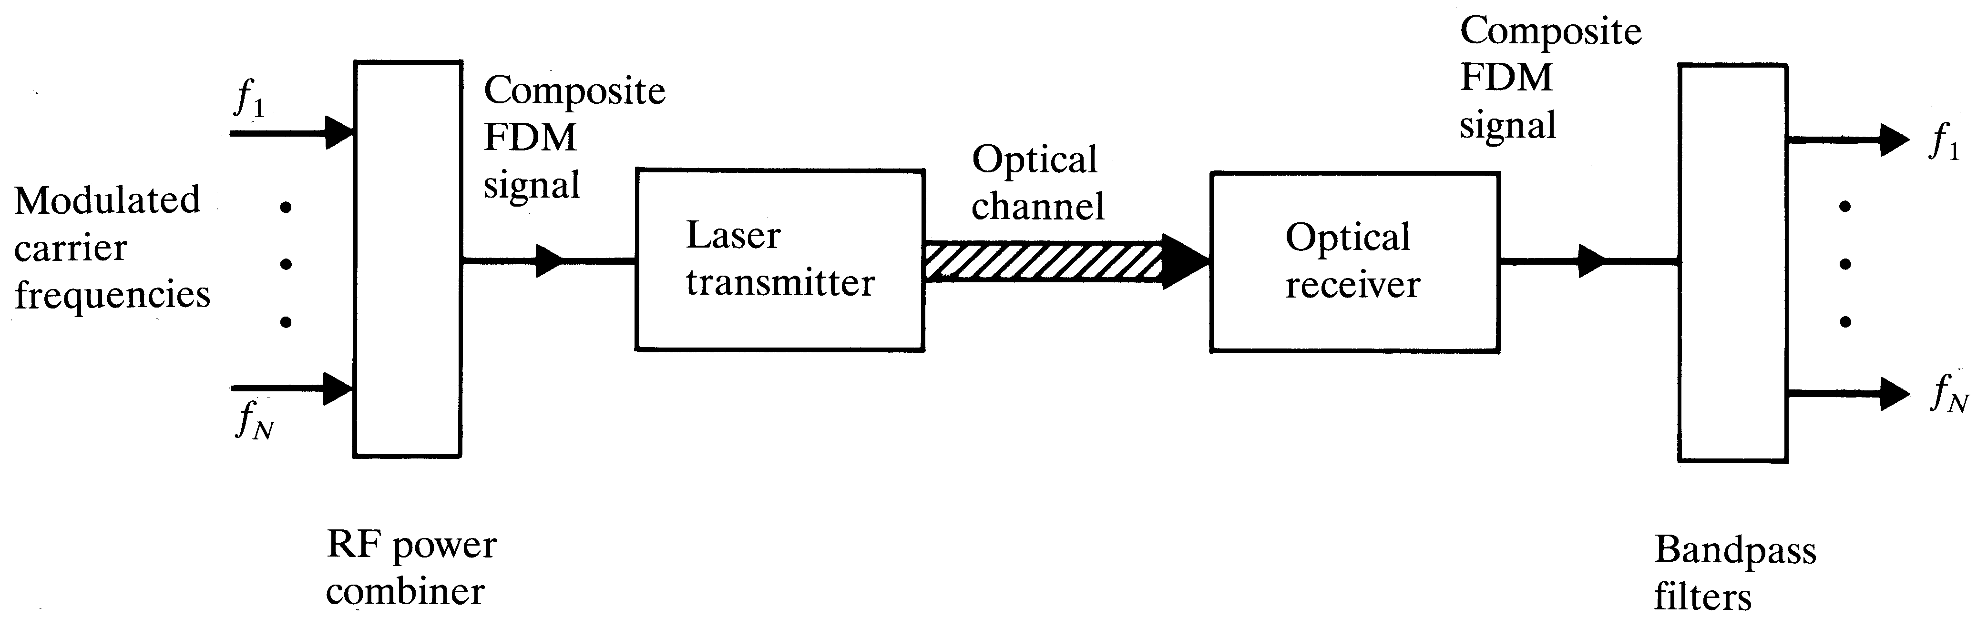
Sub-Carrier Multiplexing

Slide 14
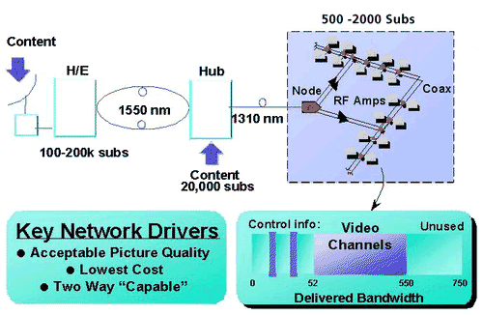
Hybrid/Fiber Coax (HFC) TV Networks

Slide 15
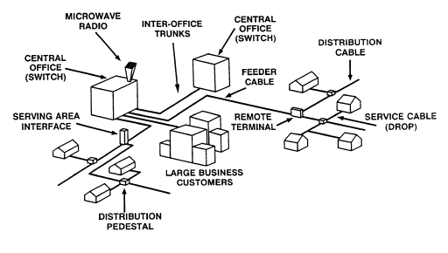
Public Switched Telephone Network (PSTN)

Slide 16
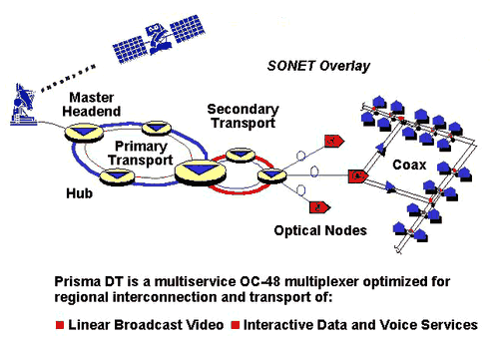
Multimedia over Fiber
(Synch. Optical Network)

Slide 17
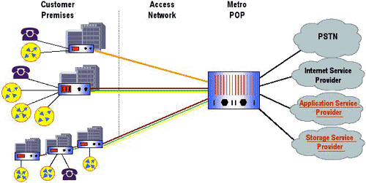
Optical Access Network

Slide 18
Radio over Fiber (ROF) for Wireless Systems
A subset of MFO systems – However, the microwave signal is transmitted into the free-space to give wireless access and mobility. Gives unique challenges.

Slide 19
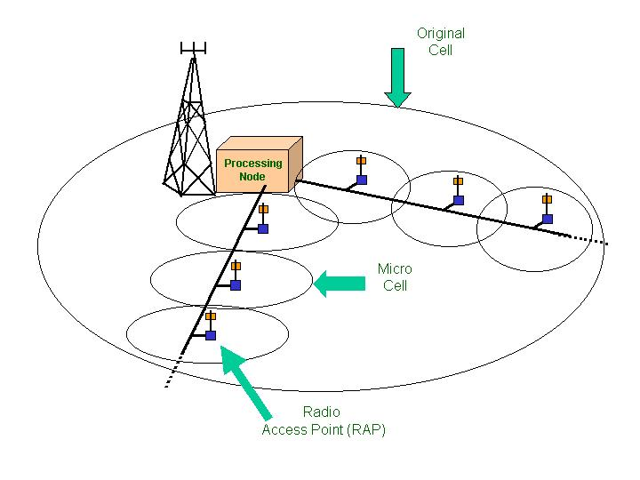
The Technology

Slide 20
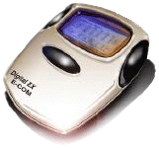
RAP
RAP
RAP
RT
Fiber Distribution
Consistent
High
Data Rate
Everywhere
Dramatic Increase in Capacity !!

Slide 21


Multi Standard Fiber-Wireless
Y
Central
Base
Station
Radio over Fiber (ROF)
RAP
(Simple)
Up/Down links
Y
RAP
802.11
voice
Y
RAP
Single ROF link can support voice and
data simultaneously
Micro
Cell

Slide 22
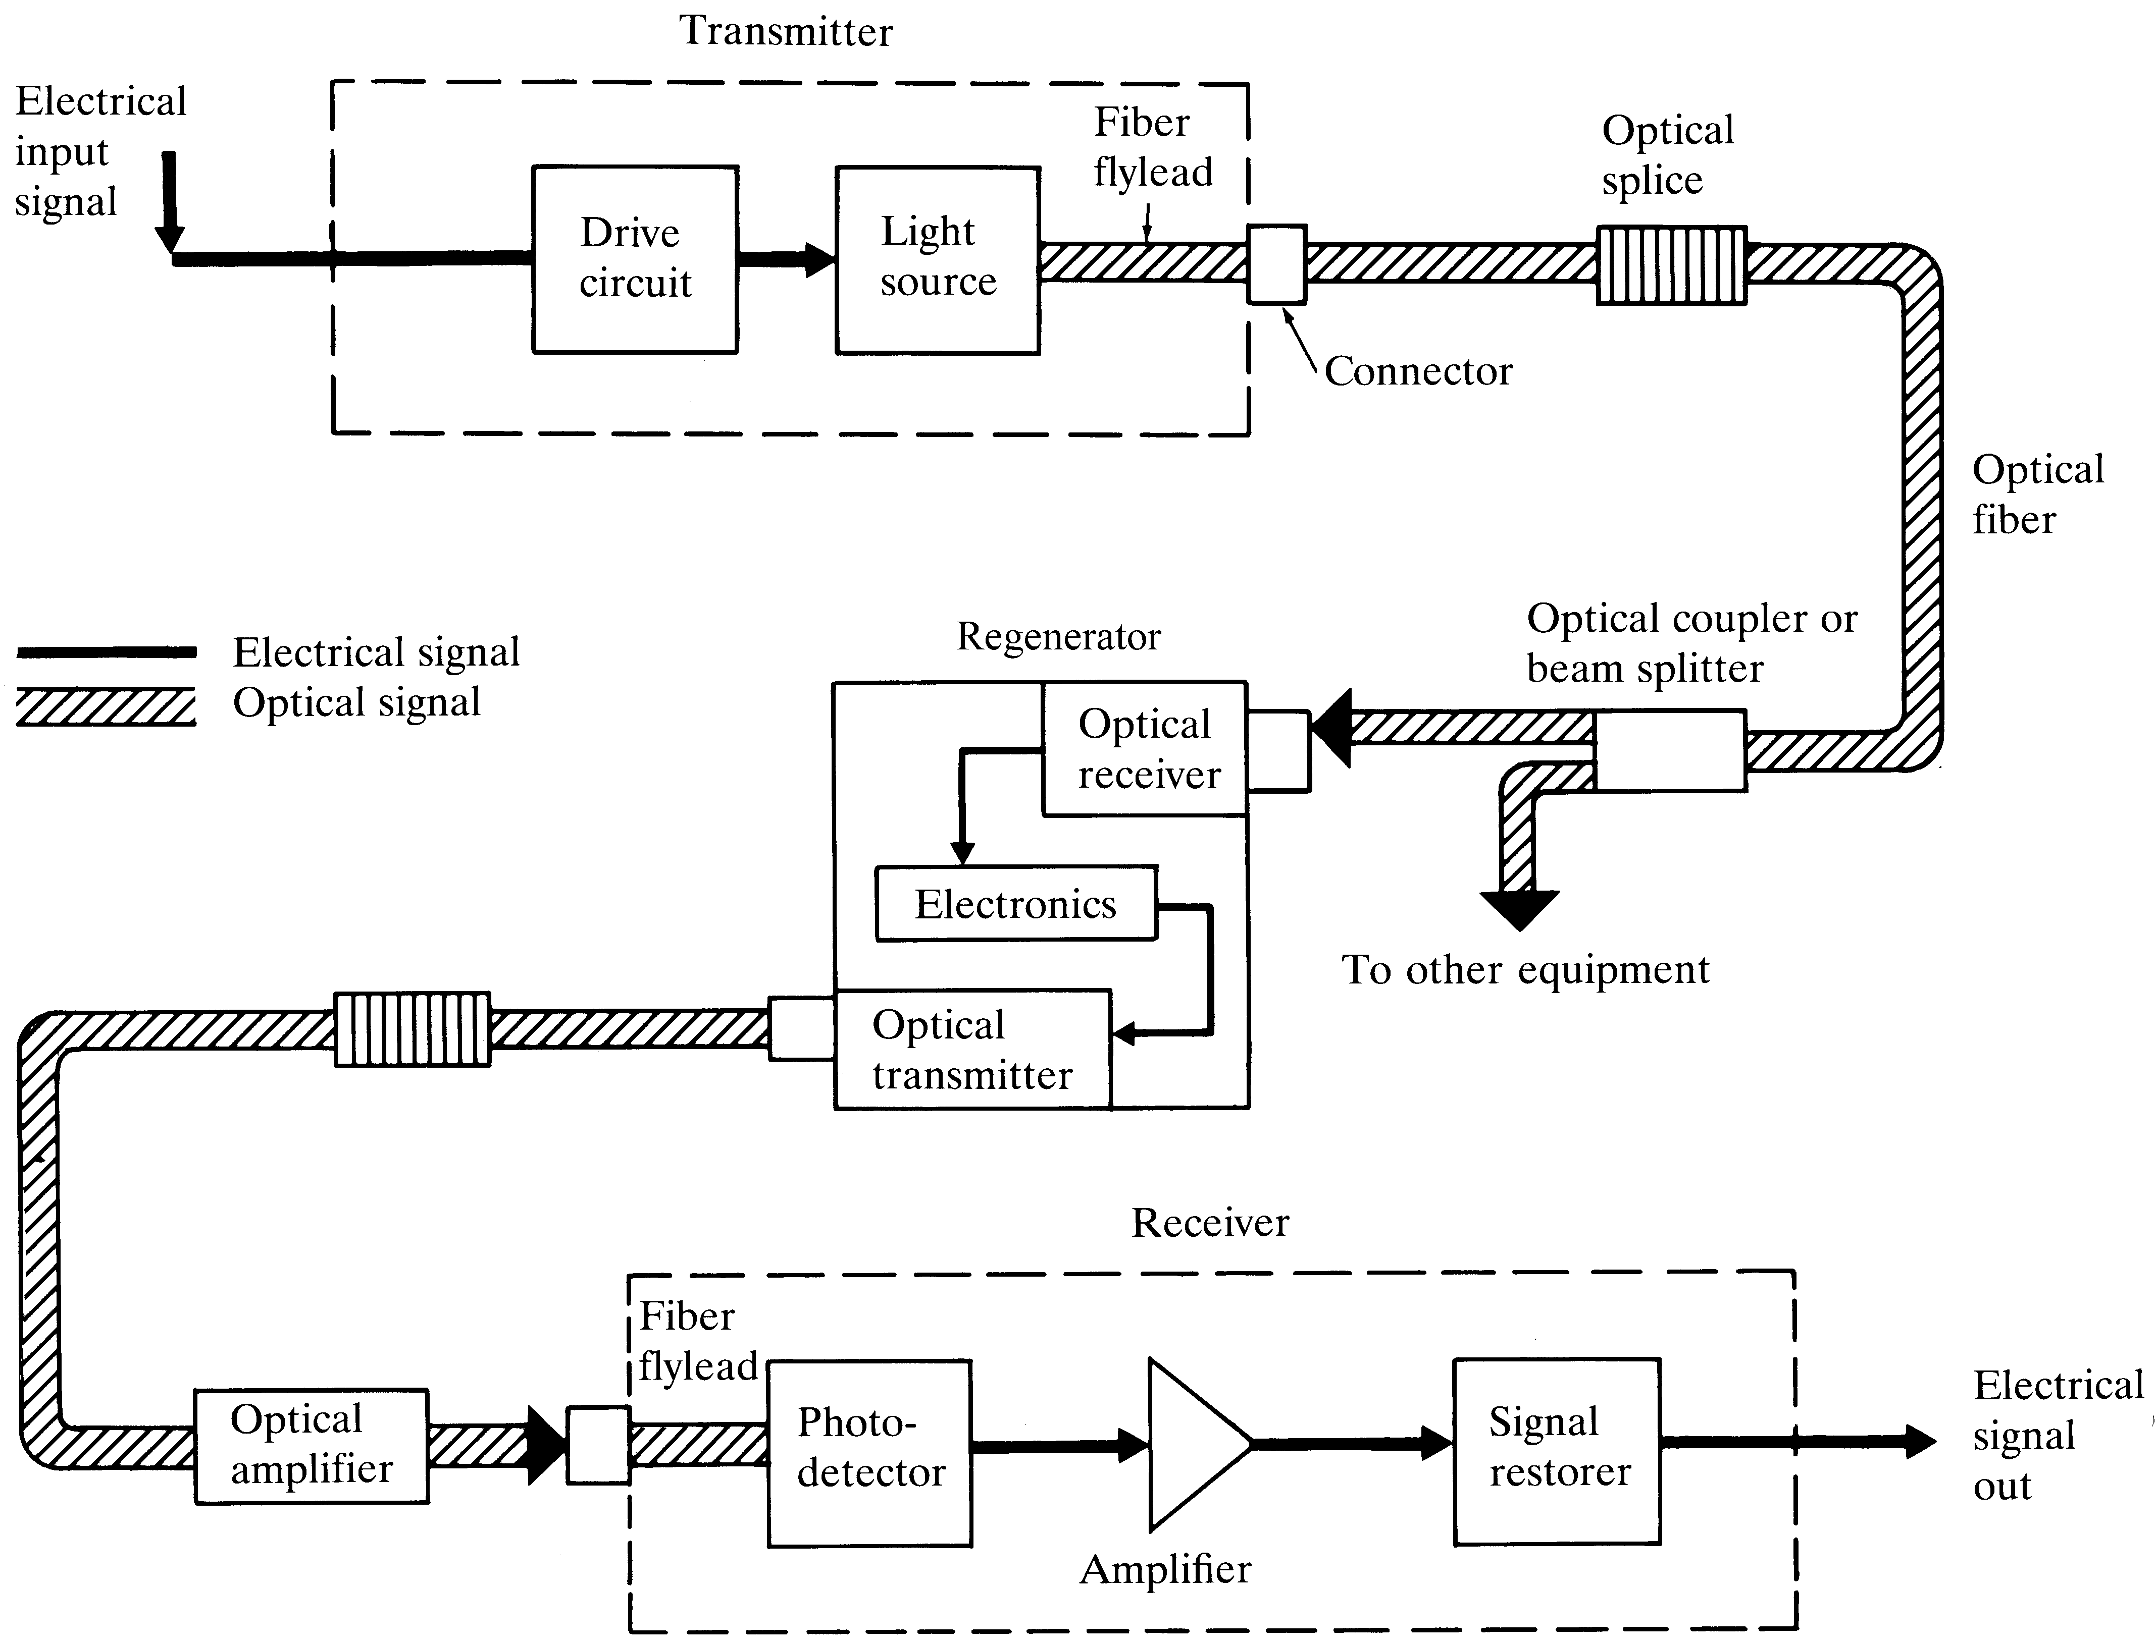
Major elements of an optical fiber link
Notes:
3

Slide 23
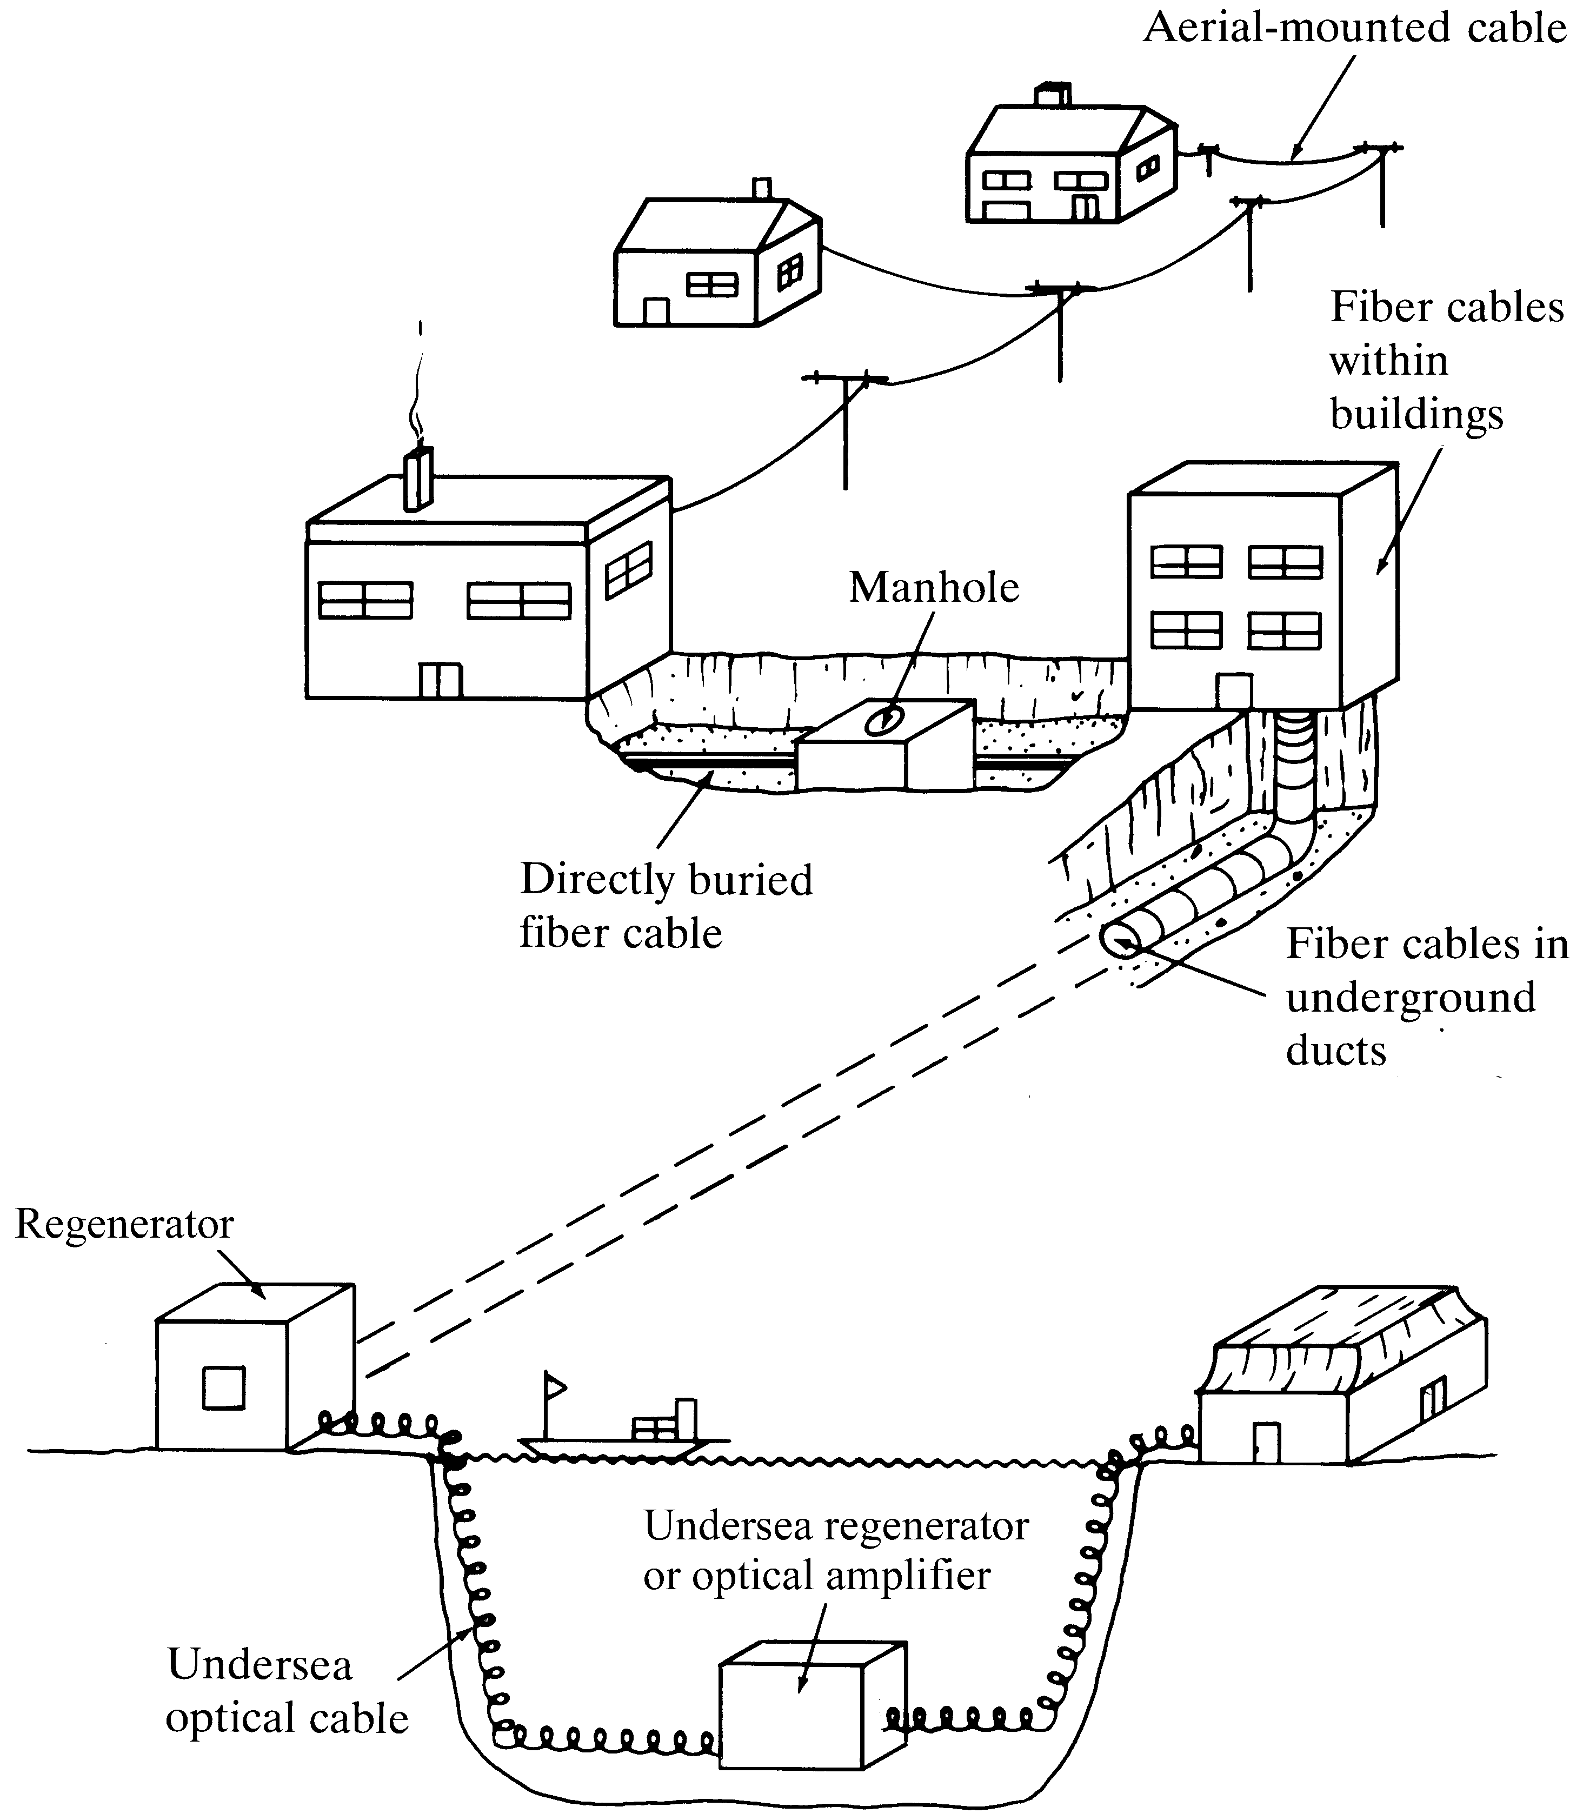
Optical fiber cable installations
Notes:
4

Slide 24
Telecom / Data Networks
Telecom networks
Have been around for more than a century
Rich in service features for voice communications, but high in cost
Switching is used to eliminate the need for direct connections between all nodes in the network
Basic unit is the 64-kb/s voice circuit
  64-kb/s circuits are multiplexed into higher-bit-rate formats (SONET/SDH)
Data networks
Have evolved since the early 1960’s from time-sharing systems to the Internet
Bare-bones service at very low cost
Basic unit is the packet or frame, not a fixed amount of bandwidth
Routing is used to eliminate the need for direct connections between all
nodes in the network

Slide 25
‘Good Old Days’ of
Telecom Systems
Analog voice circuits between customers and central office
Maximum frequency transmitted: 4 kHz
Carried on a single twisted copper-wire pair
Analog inter-central-office trunks:
Required repeaters every 2 km
Duct diameter (10 cm) limited the number of circuits
Bell Labs solution (1962): Digital interoffice trunks using DS-1 (Digital Signal Type 1) signals
A voice signal digitized at a sampling rate of 8 kHz is DS-0 (64 kbits/s)
T-1 carrier systems used since 1962: DS-1 carried on twisted pair wires,
with repeaters every 2 km to remove electromagnetic crosstalk and to
compensate for attenuation

Slide 26
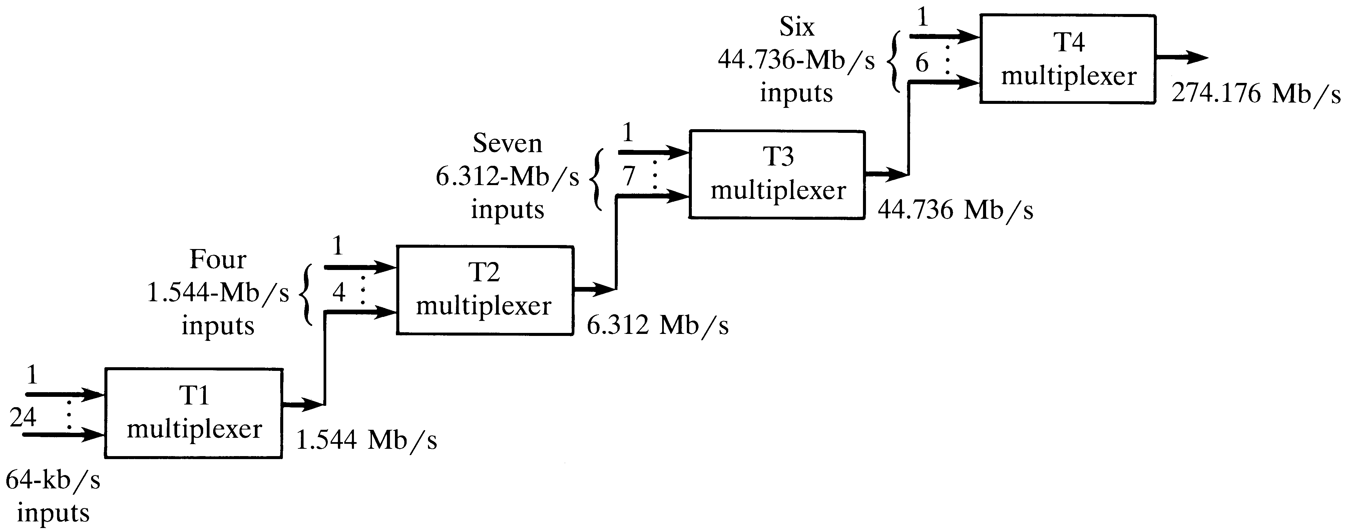
Digital Transmission Hierarchy
Called Telephony or T-Networks
Uses Copper
Notes:
1

Slide 27
First Generation Fiber Optic Systems
Purpose:
Eliminate repeaters in T-1 systems used in inter-office trunk lines
Technology:
0.8 µm GaAs semiconductor lasers
Multimode silica fibers
Limitations:
Fiber attenuation
Intermodal dispersion
Deployed since 1974

Slide 28
Second Generation Systems
Opportunity:
Development of low-attenuation fiber (removal of H2O and other impurities)
Eliminate repeaters in long-distance lines
Technology:
1.3 µm multi-mode semiconductor lasers
Single-mode, low-attenuation silica fibers
DS-3 signal: 28 multiplexed DS-1 signals carried at 44.736 Mbits/s
Limitation:
Fiber attenuation (repeater spacing ≈ 6 km)
Deployed since 1978

Slide 29
Third Generation Systems
Opportunity:
Deregulation of long-distance market
Technology:
1.55 µm single-mode semiconductor lasers
Single-mode, low-attenuation silica fibers
OC-48 signal: 810 multiplexed 64-kb/s voice channels carried at 2.488 Gbits/s
Limitations:
Fiber attenuation (repeater spacing ≈ 40 km)
Fiber dispersion
Deployed since 1982

Slide 30
Fourth Generation Systems
Opportunity:
Development of erbium-doped fiber amplifiers (EDFA)
Technology (deployment began in 1994):
1.55 µm single-mode, narrow-band semiconductor lasers
Single-mode, low-attenuation, dispersion-shifted silica fibers
Wavelength-division multiplexing of 2.5 Gb/s or 10 Gb/s signals
Nonlinear effects limit the following system parameters:
Signal launch power
Propagation distance without regeneration/re-clocking
WDM channel separation
Maximum number of WDM channels per fiber
Polarization-mode dispersion limits the following parameters:
Propagation distance without regeneration/re-clocking

Slide 31
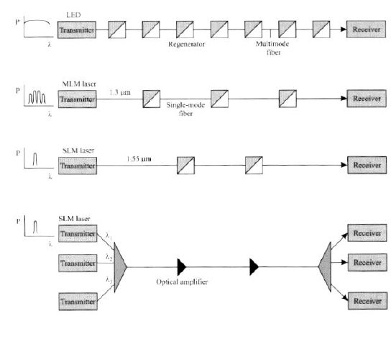
Evolution of Optical Networks

Slide 32
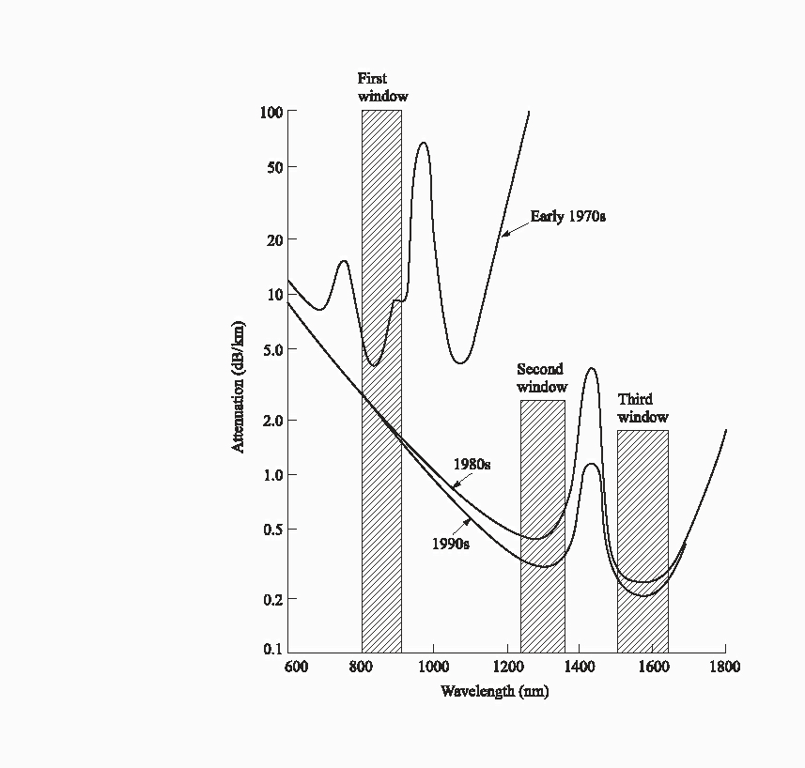
History of Attenuation
Notes:
5

Slide 33
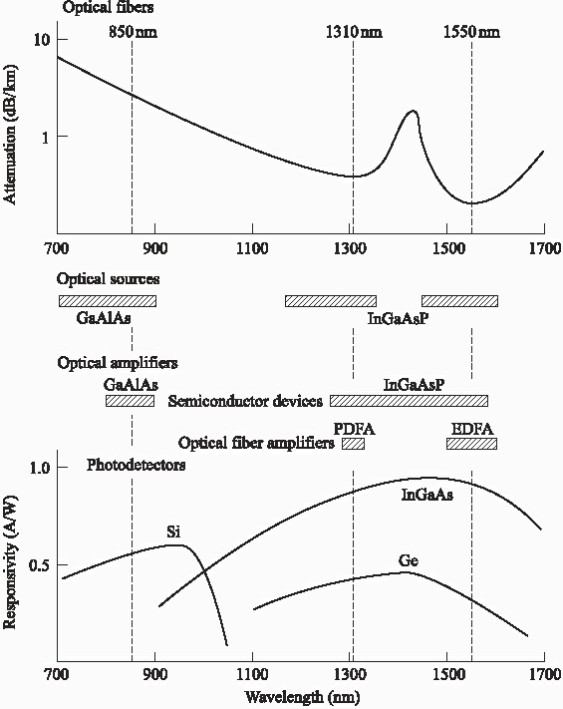
Three Windows based on
Wavelength
Notes:
2

